Slide 1



Digital assistant to aid individuals with print disabilities to interpret printed materials
Project ID: 2022-024

Slide 2


Introduction

Slide 3



What is print disability?
A print disability is a difficulty or inability to read printed material due to a perceptual, physical or visual disability [1].

Slide 4
Research Problem

Slide 5
2.2 Billion
People have a near or distance vision impairment – WHO [2]
300 million
Can be considered as print disabled [3]
1%-7%
Of all books are available in accessible formats [3]

Slide 6




Can affect everyday life, education and work
Lack of resources available in accessible mediums
Table, diagram and mathematic interpretation
Braille books cost more than normal issue
Lack of accessibility options in available tools
Cannot get third party assistance for personal, confidential documents

Slide 7

Research Objectives
To explore and identify the feasible solutions to develop an assistive application to aid individuals with print disabilities to interpret printed materials
Document segmentation and classification
Table and diagram interpretation
Text and mathematic expression interpretation
Image interpretation

Slide 8
Overall System Diagram

Slide 9


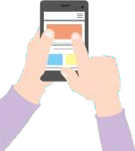

Cloud environment
Document segmentation and classification
Haptic
feedback
Gesture controlling
Interpret texts and math
Interpret Tables and graphs
Interpret Images
Voice
commands
Assembling module
Audio assistance

Slide 10
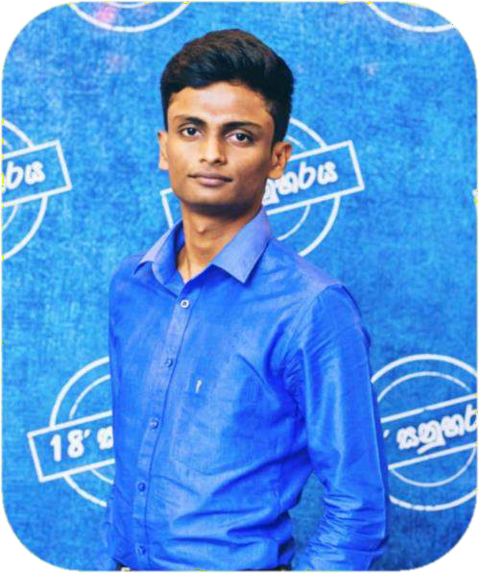



IT19187242
Priyashan Sandunhetti S. H. S.
Document zone segmentation and classification

Slide 11


Introduction
IT19187242 | Priyashan Sandunhetti S. H. S. | 2022-024

Slide 12


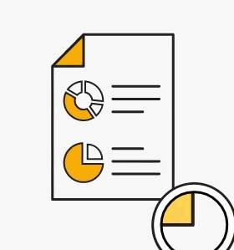
Background
Research area?
What is document zone segmentation and
classification?
Why it’s needed for this research?
IT19187242 | Priyashan Sandunhetti S. H. S. | 2022-024

Slide 13



Research Gap
Research A
Research B
Research C
Graphical Object Detection in Document Images [1]
Layout analysis and content classification in digitized books [2]
Fast CNN-Based Document Layout Analysis [3]
IT19187242 | Priyashan Sandunhetti S. H. S. | 2022-024

Slide 14






 | Research A | Research B | Research C | This solution
Assisted document capturing
Detect and enhance the document from overall scanned image(Distortions/Lighting)
Detect and classify tables in the document
Detect images and graphs separately
Detect and classify texts and mathematic expressions separately
Optimized for mobile/cloud use
IT19187242 | Priyashan Sandunhetti S. H. S. | 2022-024

Slide 15


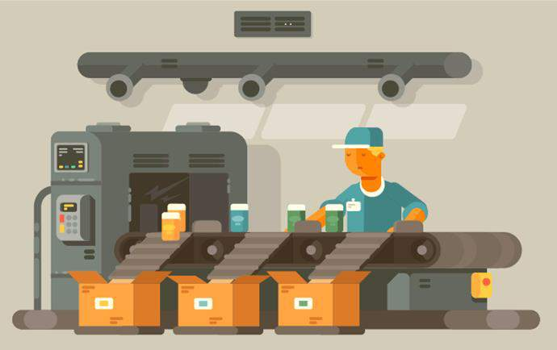

Research Problem
Majority of the users will not be able to see to capture a document
Print disabled individual might not know the exact layout of the printed material
Whole system’s accuracy depends on the classification
Scanned images will not be in the best condition
Perspective
Outside area
Lighting and shadows
IT19187242 | Priyashan Sandunhetti S. H. S. | 2022-024

Slide 16
Research Objectives
Sub objective #1
Pre-process and enhance the image quality and warp perspective inconsistencies
Main Objective
To explore and identify a document zone classification and implement an algorithm to segment scanned material
Sub objective #2
Segment and classify the content properly and direct the content to relevant algorithms to interpret
Sub objective #3
To enable disabled users the ability to scan a document by giving digital assistance with vocal guidance and assisted capturing
IT19187242 | Priyashan Sandunhetti S. H. S. | 2022-024

Slide 17

Methodology
IT19187242 | Priyashan Sandunhetti S. H. S. | 2022-024

Slide 18


Available Methods
Top-down
Bottom-up
Heuristic/Hybrid
Convolutional Neural Networks(CNN)
IT19187242 | Priyashan Sandunhetti S. H. S. | 2022-024

Slide 19
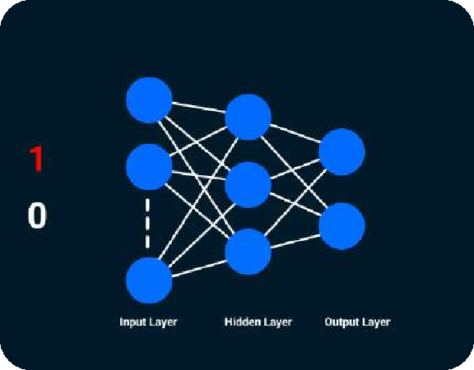
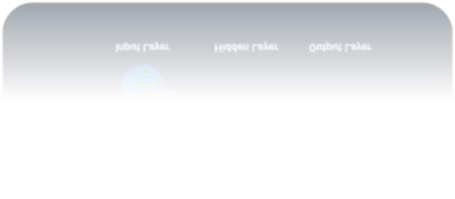
Why CNN?
Can deal with many issues in single model [5]
Can be optimized for mobile, cloud use [5]
Provides better accuracy [4]
IT19187242 | Priyashan Sandunhetti S. H. S. | 2022-024

Slide 20
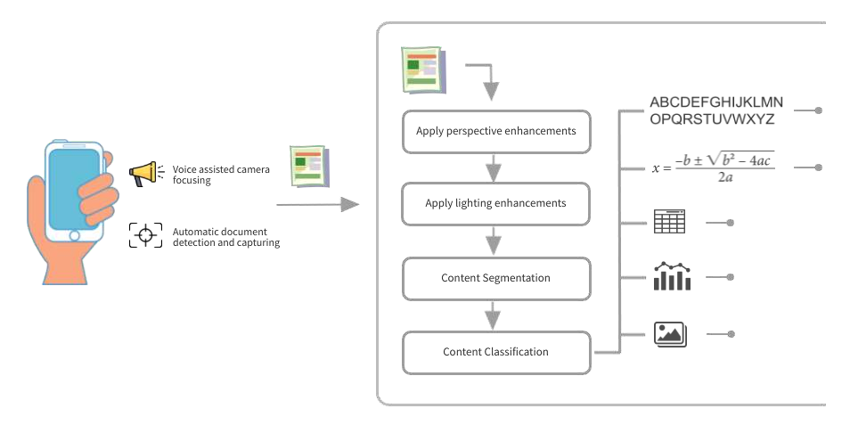
System Overview Diagram
IT19187242 | Priyashan Sandunhetti S. H. S. | 2022-024

Slide 21






Tools and Technologies
Flutter and Dart
TensorFlow Lite
Python
Scikit-image
IT19187242 | Priyashan Sandunhetti S. H. S. | 2022-024

Slide 22
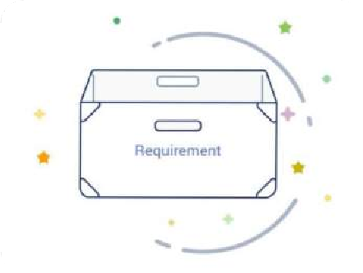

Requirements
Proper document scanning module should be in place
Functional Requirements
Scanning process should be assistive
Requirements
Document zone segmentation and classification model
Faster processing
Non-functional
Requirements
Accuracy
Well optimized
IT19187242 | Priyashan Sandunhetti S. H. S. | 2022-024

Slide 23
Work Breakdown Structure
Document segmentation
and classification
Feasibility study
Requirement analysis
System designing
Implementation
Testing
Documentation
Implement a document segmentation algorithm
Identify the problem
Gather requirements
Interface Design
Unit testing
Project charter
Implement a document classification algorithm
Design a solution
Analyze requirements
Architectural design
Integration testing
Project proposal
Well optimized
Implement assisted scanning module
Literature review
Detailed design
System testing
Research paper
Acceptance testing
Final report
IT19187242 | Priyashan Sandunhetti S. H. S. | 2022-024

Slide 24
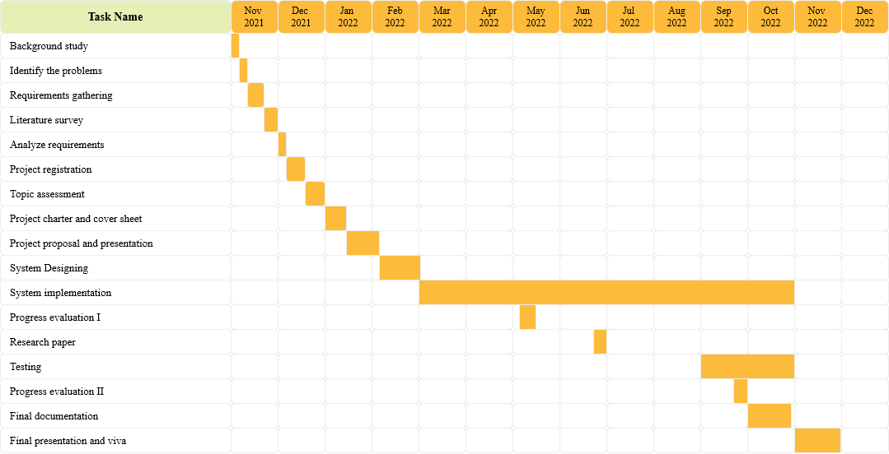
Gantt Chart
IT19187242 | Priyashan Sandunhetti S. H. S. | 2022-024

Slide 25
References
R. Saha, A. Mondal, and C. V. Jawahar, “Graphical object detection in document images,” in 2019
International Conference on Document Analysis and Recognition (ICDAR), 2019, pp. 51–58.
A. Corbelli, L. Baraldi, F. Balducci, C. Grana, and R. Cucchiara, “Layout analysis and content classification in digitized books,” in Communications in Computer and Information Science, Cham: Springer International Publishing, 2017, pp. 153–165.
D. Augusto Borges Oliveira and M. Palhares Viana, “Fast CNN-Based Document Layout Analysis,” in
Proceedings of the IEEE International Conference on Computer Vision Workshops, 2017, pp. 1173–1180.
S. Y. Chaganti, I. Nanda, K. R. Pandi, T. G. N. R. S. N. Prudhvith, and N. Kumar, “Image Classification using SVM and CNN,” in 2020 International Conference on Computer Science, Engineering and Applications (ICCSEA), 2020.
[5]P. Forczmański, A. Smoliński, A. Nowosielski, and K. Małecki, “Segmentation of scanned documents using deep-learning approach,” in Advances in Intelligent Systems and Computing, Cham: Springer International Publishing, 2020, pp. 141–152.
IT19187242 | Priyashan Sandunhetti S. H. S. | 2022-024

Slide 26
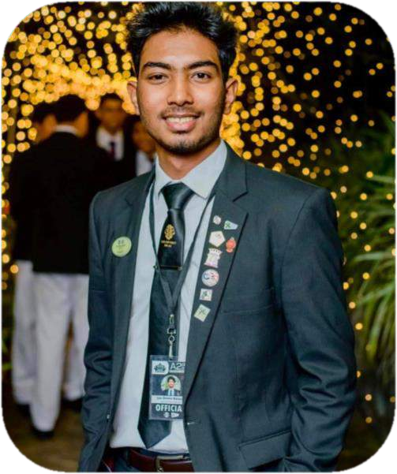
IT19156484
Dilitha Ranjuna G.P.
Read tables and comprehension of chart description model within the system

Slide 27
Introduction
IT19156484
Dilitha Ranjuna G.P.
2022-024

Slide 28



Research Gap
Research A
Research B
Research C
“TableNet” Deep learning model for table detection and tabular data[1]
Table recognition and semantic interpretation system[3]
“Chart-Text” Automated chart image descriptor[2]
IT19156484
Dilitha Ranjuna G.P.
2022-024

Slide 29

Research Gap
Row and column detection
Provide guidance to scan
Table
Detection
Identify
text
Identify
charts
Realtime
Scanning
Our Solution
Research A
Research B Research C
IT19156484
Dilitha Ranjuna G.P.
2022-024

Slide 30
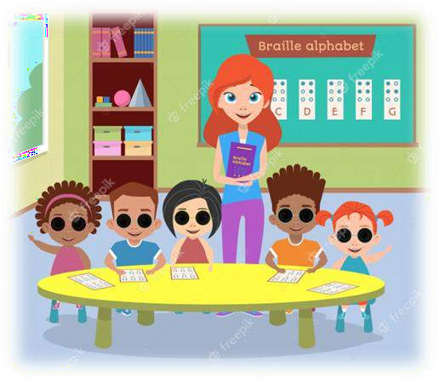

Research Problem
For visually impaired people, there is no such thing as a separate table identifying tool.
There is no assistant tool that scans graphs and tables in a way that a blind person can use.
Rare to find that explaining graphs for blind or visually impaired person.
Content cannot be recognized even if a third-party tool is used to identify the table structure.
IT19156484
Dilitha Ranjuna G.P.
2022-024

Slide 31
Objectives
Sub objective 1
Create a model to translate the document's
tables and diagrams into basic plain
English.
Main Objective
To identify a proper model to read a table and comprehension of diagram description model within the system.
Sub objective 2
To allow voice control, develop a speech
recognition system.
Sub objective 3
Create a speech engine to provide guide
and information to the user.
IT19156484
Dilitha Ranjuna G.P.
2022-024

Slide 32
Methodology

Slide 33
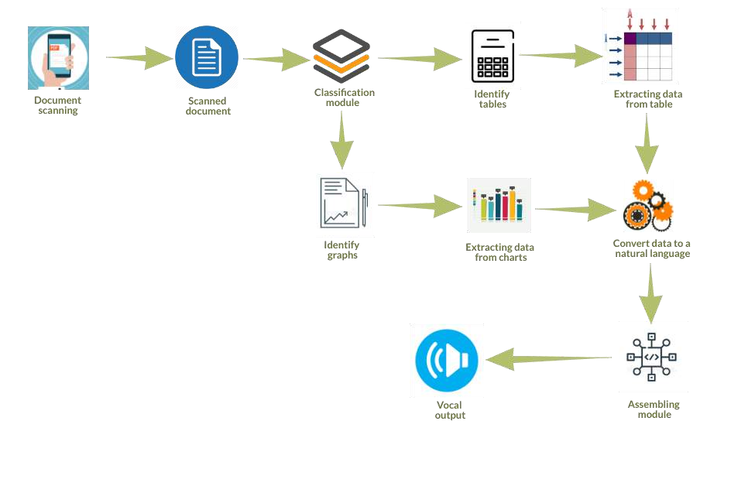
System Diagram
IT19156484
Dilitha Ranjuna G.P.
2022-024

Slide 34
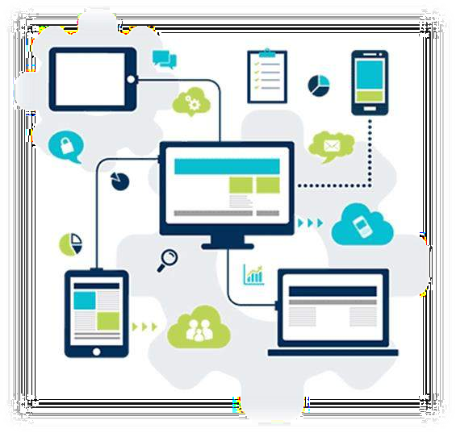
Technologies to be used
Technologies
Flutter
Algorithms
String matching algorithm
Dart
Python
KNN
Firebase
SVM
Github
IT19156484
Dilitha Ranjuna G.P.
2022-024

Slide 35
Requirements
User requirements
Functional
requirements
Non - functional
requirements
The tables and charts should be identified properly.
User should follow guidelines given by voice assistant tool.
Visually impaired or any user can use this tool.
There should be simple plain English explanations.
The user must provide the gestures and voices properly to the system.
Provide more reliable when reading legal documents.
IT19156484
Dilitha Ranjuna G.P.
2022-024

Slide 36
Work Breakdown Structure (WBS)
Read tables and comprehension of chart description
1.0 Specification
2.0 Design
3.0 Implementation
4.0 Testing
5.0 Documentation
1.1 Scope definition
1.2 Requirement definition
1.3 Define a solution
1.4 Scheduling
1.5 Requirement gathering
1.6 Analyse requirements
2.1 Selecting delivery platform
2.2 Design interfaces
2.3 Architectural design
2.4 Algorithm
3.1 Implement table identifying model
3.2 Implement chart identifying model
3.3 Implement Text to speech engine
3.4 Implement speech recognition
4.0 Unit testing
3.0 Integration testing
3.0 System testing
3.0 Acceptance testing
5.1 Project charter
5.2 Project proposal
5.3 Research paper
5.4 Final Report
IT19156484
Dilitha Ranjuna G.P.
2022-024

Slide 37
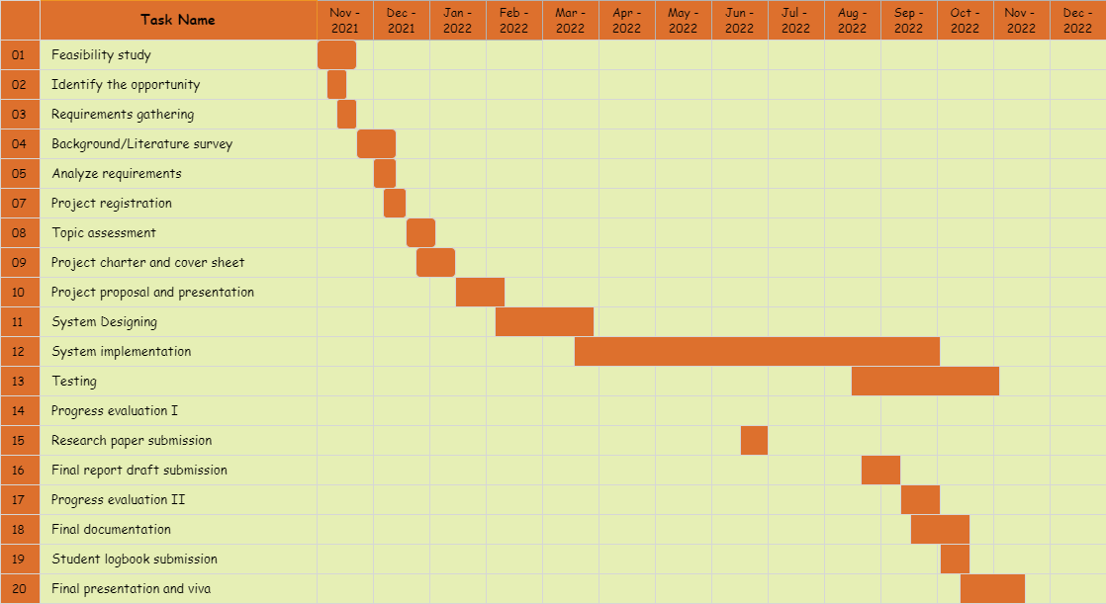

Gannt Chart
IT19156484
Dilitha Ranjuna G.P.
2022-024

Slide 38

References
Paliwal, S. S., Vishwanath, Rahul, R., Sharma, M., & Vig, L. (2019). TableNet: Deep learning model for end-to-end table detection and tabular data extraction from scanned document images. 2019 International Conference on Document
Analysis
and Recognition (ICDAR), 128–133.
Balaji, A., Ramanathan, T., & Sonathi, V. (2018). Chart-Text: A fully automated chart
image descriptor. In arXiv [cs.CV]. http://arxiv.org/abs/1812.10636
Namysl, M., Esser, A. M., Behnke, S., & Köhler, J. (2021). Flexible table
recognition
and semantic interpretation system. In arXiv [cs.CV]. https://www.ais.uni- bonn.de/papers/VISAPP_2022_Namysl.pdf
IT19156484
Dilitha Ranjuna G.P.
2022-024

Slide 39
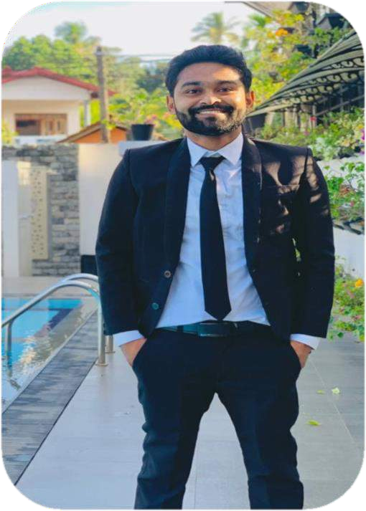
IT19117492
Prabash K.V.A.S.
Explain text and complex mathematical expressions to the user in a meaningful way.

Slide 40
Introduction

Slide 41
Research Gap
Research A
Research B
Research C
Handwritten Bangla Numeral Recognition Using
Ensembling of Convolutional Neural Network[1]
Learning Fine- Grained Image Representations for Mathematical Expression Recognition[2]
Handwritten Mathematical Expression Recognition via Attention Aggregation
based Bi-directional Mutual Learning[3]

Slide 42





Research Gap
Research A
Research B
Research C
Explain the mathematic equations and plain text in simple English.
(Text only)
(Math only)
(Math only)
(Math and Text)
Mathematics equation recognition
Optimized for mobile, cloud use
Add grammar rule to explain mathematical equation
IT19117492
Prabash K.V.A.S
2022-024

Slide 43
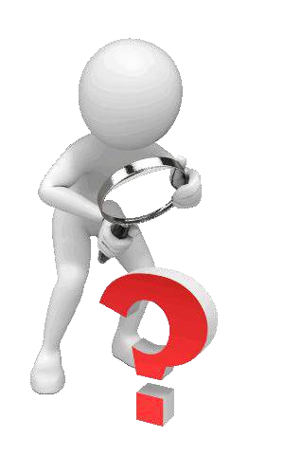
Research Problem
No accessible to read the printed and handwritten material of print disabled individuals
Mathematics in brail language
also hard to comprehend
Handwritten word part
unrecognize
No proper method to describe mathematics equations in English
Mathematical equation not
clearly identified
IT19117492
Prabash K.V.A.S
2022-024

Slide 44

Main Objective
To explore and identify an algorithm to explain text and complex mathematical expressions to the user in meaningful way.
IT19117492
Prabash K.V.A.S
2022-024

Slide 45
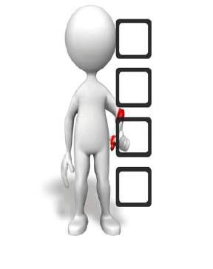
Sub-Objectives
Improve the identifying the math's and plain text
Handwritten text
reading
Improve the recognizing mathematics symbols
Mathematics equation read mathematics way
IT19117492
Prabash K.V.A.S
2022-024

Slide 46

Methodology
IT19117492
Prabash K.V.A.S
2022-024

Slide 47
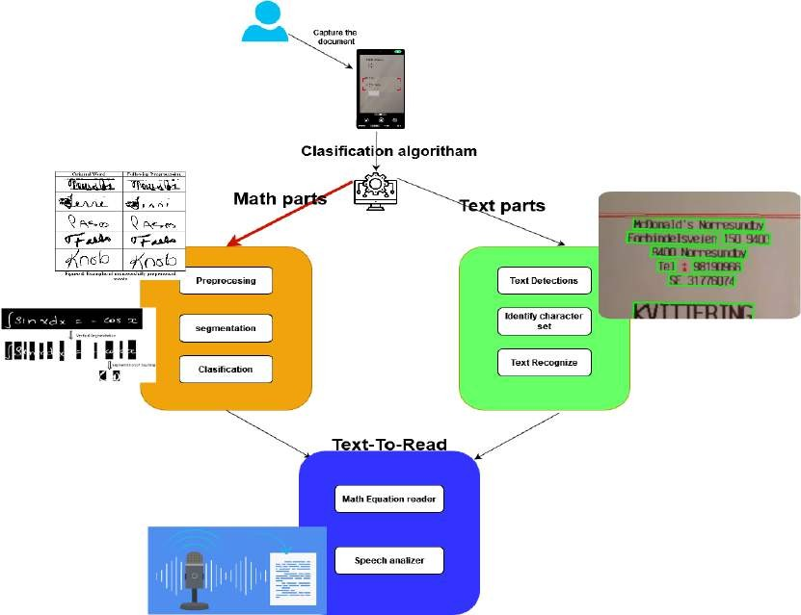
System Diagram
IT19117492
Prabash K.V.A.S
2022-024

Slide 48
Available methods
Support Vector Machine (SVM)
Random Forests (RF)
k Nearest Neighbor (kNN)
Decision Tree (DT)

Slide 49





Tools and Technology
Technology
Algorithms
NumPy library to the preprocessor
Recurrent Neural Networks
(LSTM)
Dataset
CROHME
IAM (IAM Handwriting) MNIST
Fluter
Dart Python Firebase Github
IT19117492
Prabash K.V.A.S
2022-024

Slide 50
Requirement
Non - functional requirements
User requirements
Functional
requirements
Usability – VI students can easily use this app without any hassle
Availability – This app should be able to use anywhere they want.
Performance – Capturing the text of the printed material is with the high accuracy
Reliability – Always provide high accuracy of capture output
User should have basic knowledge of the app manage
Capture the text correctly through the camera.
This app should be equally impressive the vision-impaired people and normal people.
Capture result delivers high volume audio in plain English
IT19117492
Prabash K.V.A.S
2022-024

Slide 51
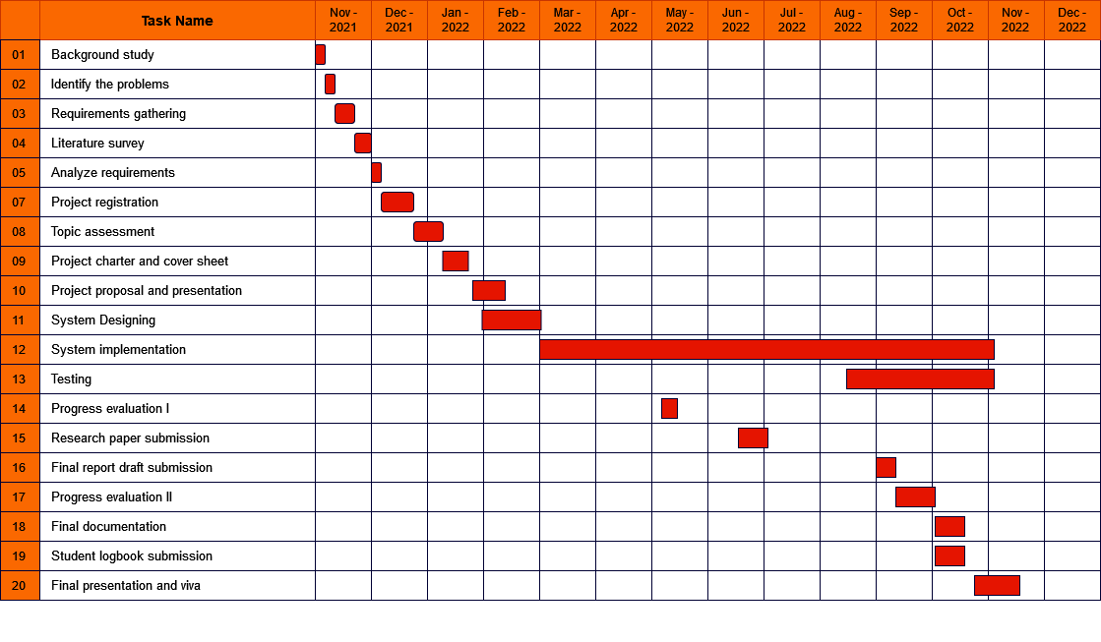
Gannt Chart
IT19117492
Prabash K.V.A.S
2022-024

Slide 52
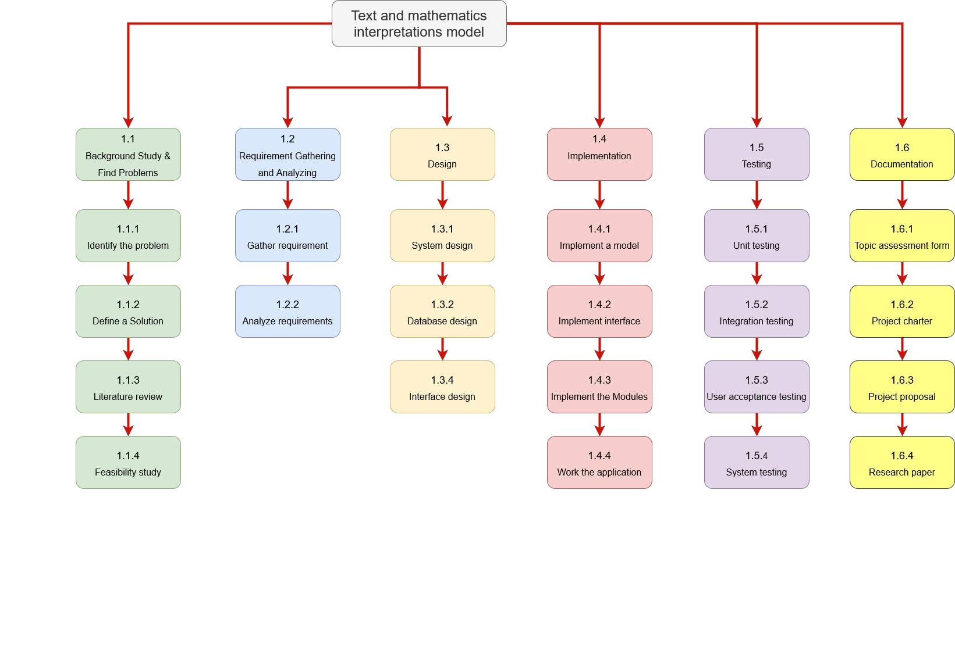
Work Breakdown Structure (WBS)
IT19117492
Prabash K.V.A.S
2022-024

Slide 53
References
R. Noor, K. Mejbaul Islam and M. J. Rahimi, "Handwritten Bangla Numeral Recognition Using Ensembling of Convolutional Neural Network," 2018 21st International Conference of Computer and Information Technology (ICCIT), 2018, pp. 1-6, doi: 10.1109/ICCITECHN.2018.8631944.
S. Bender, M. Haurilet, A. Roitberg and R. Stiefelhagen, "Learning Fine-Grained Image Representations for Mathematical Expression Recognition," 2019 International Conference on Document Analysis and Recognition Workshops (ICDARW), 2019, pp. 56-61, doi: 10.1109/ICDARW.2019.00015.
Bian, X., Qin, B., Xin, X., Li, J., Su, X., & Wang, Y. (2021). Handwritten mathematical expression recognition via attention aggregation based Bi- directional mutual learning. In arXiv [cs.CV]. http://arxiv.org/abs/2112.03603
IT19117492
Prabash K.V.A.S
2022-024

Slide 54
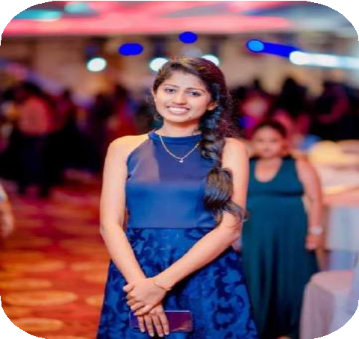
IT19392172
Sanduni Madara P.G
Identifying a proper image captioning approach to facilitate interpreting an image in a document
IT19392172 | Sanduni Madara P.G. | 2022-024

Slide 55
Introduction
IT19392172 | Sanduni Madara P.G. | 2022-024

Slide 56
Research Gap
Research A
Research B
Research C
Image captioning algorithm based on multi-branched CNN and Bi-LSTM [1]
A new image captioning approach for visually impaired people [2]
Image captioning using deep neural architectures [3]
IT19392172 | Sanduni Madara P.G. | 2022-024

Slide 57


 | Research A | Research B | Research C | This solution
Describing colors within the image
Describe the surrounding content other than the main subject
Introduce an attention mechanism to select key features
Describe the images in a way even for people who are blind since the birth can feel
Optimized for mobile/cloud use
IT19392172 | Sanduni Madara P.G. | 2022-024

Slide 58

Research Problem
Every time, cannot get a third-party assistant for image identification.
Incapable to distinguish the needed information of an image in a printed document without depending on others
Inability to interpret an image in a printed document without others’ assistance
Lack of understanding / sufficient explanation of the images in existing tools
Cannot have a descriptive explanation of an image through braille
Existing tools lack the accessibility
options for print disabled individuals
IT19392172 | Sanduni Madara P.G. | 2022-024

Slide 59
Research Objectives
Sub Objective 01
To identify a proper image identification model to extract image features
Main Objective
To explore and identify the feasible system with a proper image interpretation model to facilitate reading a printed document
Sub Objective 02
To identify a proper language model to
generate a descriptive explanation
Sub Objective 03
To develop a gesture-controlled process with a haptic feedback system in the mobile application.
IT19392172 | Sanduni Madara P.G. | 2022-024

Slide 60
Methodology
IT19392172 | Sanduni Madara P.G. | 2022-024

Slide 61
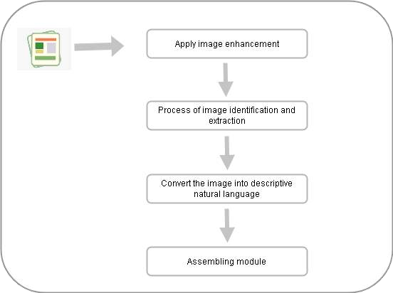
System diagram
IT19392172 | Sanduni Madara P.G. | 2022-024

Slide 62


Tools and Technologies
Flutter
Github
Dart
Python
IT19392172 | Sanduni Madara P.G. | 2022-024

Slide 63


Techniques and Algorithms
Convolutional Neural Network(CNN)
A neural network used in image recognition and extraction [4]
Automatically detects the important features without any
human supervision [4]
Long Short-Term Memory
(LSTM)
Recurrent neural network capable of converting data
into natural language
IT19392172 | Sanduni Madara P.G. | 2022-024

Slide 64
Requirements
Functional Requirements
Image Captioning
Color describing
Extract data from the image
Generate meaningful captions
Further description of the image using surrounded objects near main subject
Non-Functional Requirements
Accuracy
Availability
Well Optimized
IT19392172 | Sanduni Madara P.G. | 2022-024

Slide 65
Work Breakdown Structure (WBS)
Identifying a proper image captioning approach to facilitate image interpreting an in a document
Feasibility study
Requirement analysis
Design
Implementation
Testing
Documentation
Identify the
problem
Gather
requirements
System Design
Implement an image
identification algorithm
Unit testing
Project charter
Design a solution
Analyze requirements
Interface Design
Implement a language model
Integration testing
Project proposal
Literature
review
Well optimized
User acceptance
testing
Research paper
System testing
Final report
IT19392172 | Sanduni Madara P.G. | 2022-024

Slide 66
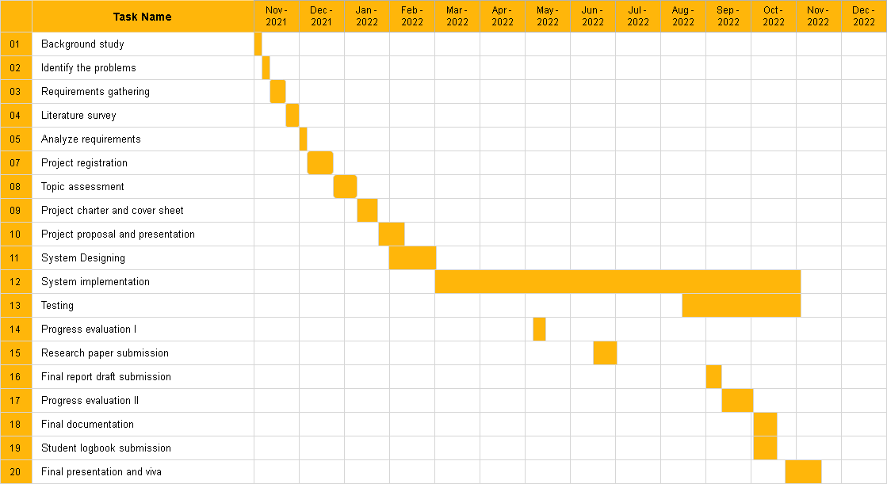
Gantt Chart
IT19392172 | Sanduni Madara P.G. | 2022-024

Slide 67
References
[1]
S. He, Y. Lu, and S. Chen, “Image captioning algorithm based on multi-branch CNN and bi-
LSTM,” IEICE Trans. Inf. Syst., vol. E104.D, no. 7, pp. 941–947, 2021.
B. Makav and V. Kilic, “A new image captioning approach for visually impaired people,” in 2019 11th International Conference on Electrical and Electronics Engineering (ELECO), 2019, pp. 945–949.
P. Shah, V. Bakrola, and S. Pati, “Image captioning using deep neural architectures,” in 2017 International Conference on Innovations in Information, Embedded and Communication Systems (ICIIECS), 2017, pp. 1–4.
A. Dertat, “Applied Deep Learning - Part 4: Convolutional neural networks,” Towards Data Science, 08-Nov-2017. [Online]. Available: https://towardsdatascience.com/applied-deep- learning-part-4-convolutional-neural-networks-584bc134c1e2. [Accessed: 31-Jan-2022].
J. Brownlee, “A gentle introduction to long Short-Term Memory networks by the experts,” Machine Learning Mastery, 23-May-2017. [Online]. Available: https://machinelearningmastery.com/gentle-introduction-long-short-term-memory- networks-experts/. [Accessed: 31-Jan-2022].
[2]
[3]
[4]
[5]
IT19392172 | Sanduni Madara P.G. | 2022-024

Slide 68
Supportive Information

Slide 69



Commercialization
Spread the word around people with disabled communities
Sponsor content creators with similar disabilities
Promote the system on platforms where vision impaired visits the most(Audiobooks, Radio)
Make more online presence by creating social media pages for the app

Slide 70


Budget for overall system
Item | Cost(RS)
App publishing cost on google play | 5000.00
Backend hosting cost | 10000.00
Paper publishing cost | 5000.00
Total | 20000.00

Slide 71
References in overall project description
“What is print disability,” Visionaustralia.org. [Online]. Available: https://www.visionaustralia.org/services/print-accessibility/what-is-print-disability. [Accessed: 31-Jan- 2022].
“Blindness and vision impairment,” Who.int. [Online]. Available: https://www.who.int/news-room/fact- sheets/detail/blindness-and-visual-impairment. [Accessed: 31-Jan-2022].
B. Okpeh, “Towards ending the information poverty among persons with print disabilities: A proposed draft
(amendment) bill for disability diversification of the national library of Nigeria,” SSRN Electron. J., 2021.

Slide 72



Thanks!
Any questions?
CREDITS: This presentation template was created by Slidesgo, including icons by Flaticon, and infographics & images by Freepik

